Slide 1

On Being a Number:
Specialty Background Checks
in Washington State
Eric Dunn, Staff Attorney
Northwest Justice Project
401 Second Ave. S., Ste. 407
Seattle, Washington 98104
Tel. (206) 464-1519, ext. 234
EricD@nwjustice.org

Slide 2
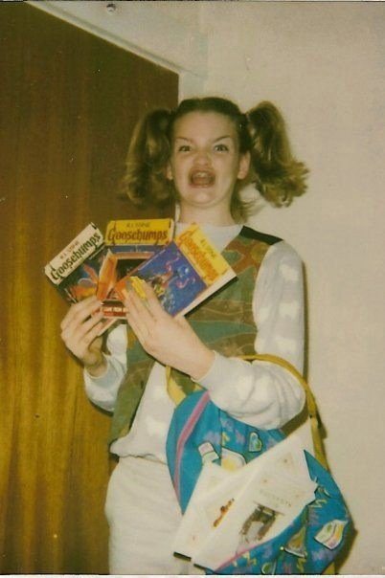
Ermergerd. Mah permernernt rekerd!
Many people believe there exists, in some mysterious place, a single, meticulously updated “permanent record” on each person that is accessible to employers, housing providers, educational institutions, lenders, police and other government agencies, et al.

Slide 3
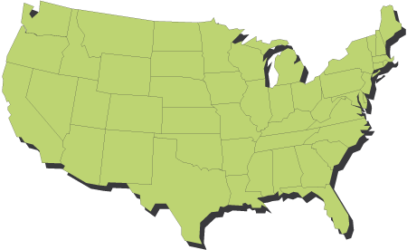

Information is kept in disparate places. Data miners gather information and generate “consumer reports.” Different consumer reports come from different sources and contain different types of information.

Slide 4
What is a “Consumer Report?”
“[A]ny written, oral, or other communication of any information by a consumer reporting agency bearing on a consumer’s credit worthiness, credit standing, credit capacity, character, general reputation, personal characteristics, or mode of living which is used or expected to be used or collected in whole or in part for the purpose of serving as a factor in establishing the consumer’s eligibility for— (A) credit or insurance to be used primarily for personal, family, or household purposes; (B) employment purposes; or (C) any other purpose authorized under [15 USC] 1681b.”
15 USC 1681a(d)
RCW 19.182.010(4)(a)

Slide 5
Consumer Report: Redux
Any written, oral, or other communication
By a consumer reporting agency
Of any information bearing on a consumer’s:
Credit worthiness, standing, capacity,
Character, reputation, characteristics, mode of living
Used or collected, wholly or partly, as factor for:
Consumer credit, insurance, housing, employment
License or other government benefit
Other legitimate business need:
Transaction initiated by consumer; or
In connection with existing account

Slide 6


Investigative Consumer Reports
Consumer report that includes information “obtained through personal interviews with neighbors, friends, or associates . . . or with others with whom the consumer is acquainted or who may have knowledge”
  15 USC 1681a(e); RCW 19.182.010(10)

Slide 7
Consumer Reports: Exclusions (RCW 19.182.010(4)(b))
Report solely concerning transactions or experiences between the consumer and the person making the report
A report by a credit card (or similar device) issuer approving or authorizing a specific extension of credit
A report to a third party, who requested a specific extension of credit directly to a consumer, whether or not to extend the credit, if consumer is informed
A list compiled by a CRA for a client to use in direct marketing of goods or services (but not offers of credit)
A report solely conveying a decision whether to guarantee a check in response to a third party’s request
A report furnished in connection with commercial credit

Slide 8
Common Consumer Reports
Financial credit reports
Criminal background checks
Landlord/Employment verification
Reference interviews
Banking/checking account reports
Professional licensing reports

Slide 9
Most “specialty” screening reports, such as employee background checks used in hiring and promotion decisions, or “tenant-screening reports” that residential landlords use for choosing tenants, are actually compilations that combine multiple consumer reports into a single package.

Slide 10

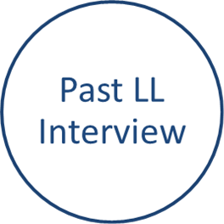
Eviction
Credit
Criminal
Tenant/Employment Screening Report

Slide 11
Fair Credit Reporting Act (X2)
Federal: 15 USC 1681 et seq.
State: RCW 19.182 et seq.
To whom the FCRAs pertain:
  Consumer Reporting Agencies
  Users (of consumer reports)
  Furnishers (of consumer information)
    Federal only

Slide 12
What the FCRAs regulate
Who may obtain a consumer report
When a consumer report may be procured
What consumer report may contain
How CRAs must prepare consumer reports

Slide 13
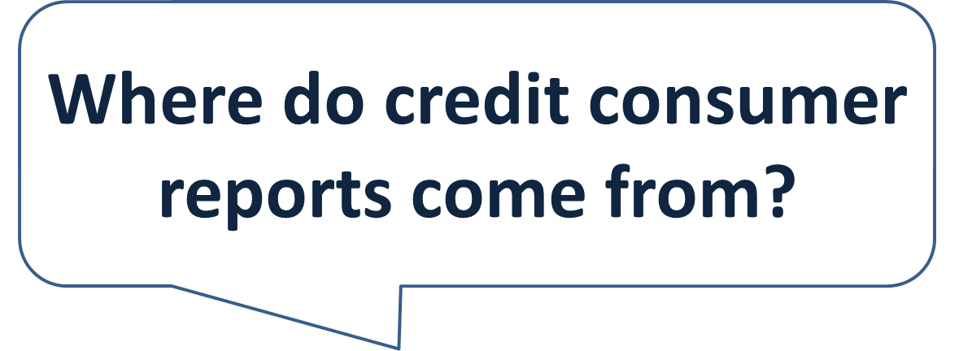
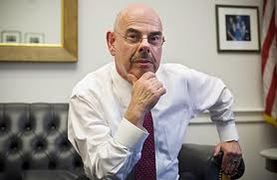

Slide 14
Consumer Reporting Agencies
“The term “consumer reporting agency” means any person which, for monetary fees, dues, or on a cooperative nonprofit basis, regularly engages in whole or in part in the practice of assembling or evaluating consumer credit information or other information on consumers for the purpose of furnishing consumer reports to third parties, and which uses any means or facility of interstate commerce for the purpose of preparing or furnishing consumer reports.”
-- 15 USC 1681a(f)
-- RCW 19.182.010(5)

Slide 15
CRAs: Evil Private Corporations
“Big 3” Financial Credit Reports
Equifax, Experian, TransUnion
Tenant/EmploymentOOn-Site Manger, HireRight, FAS, Kroll Factual Data
Criminal Background
Choicepoint (LexisNexis), Intelius, USIS
Other specialty CRAs
Chexsystems, Fair Isaacs, etc.

Slide 16

CRA
Public Records
Furnishers
User
Other CRAs
Specialty Screening
Step 1: CRA obtains information from (private ) furnishers, public records, and other CRAs
Step 2: CRA compiles information into a report, transmits to end users (such as landlords, employers)

Slide 17
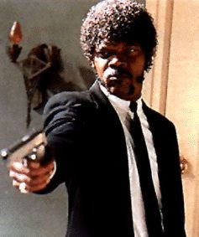
What does a consumer report look like?

Slide 18
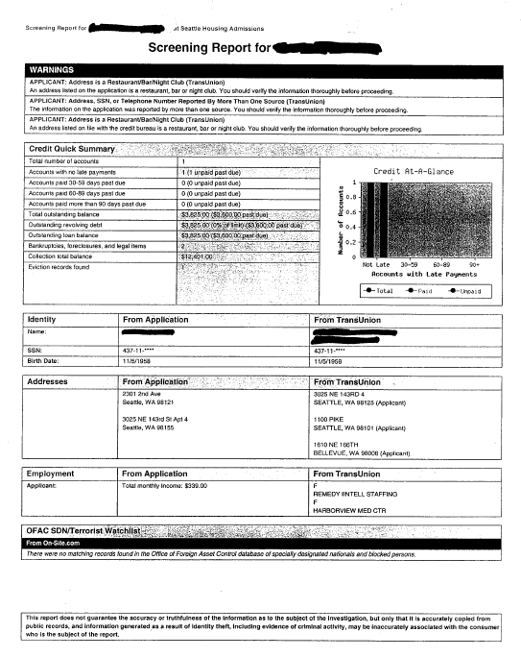
Miscellaneous Disclaimers
Credit Information
ID Verification
Employment Verification
Terrorist Database Search
Public Records Disclaimer

Slide 19
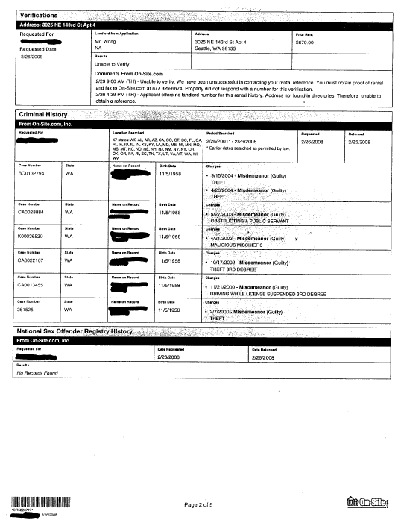
Reference Check
Criminal History
Sex Offender Check

Slide 20
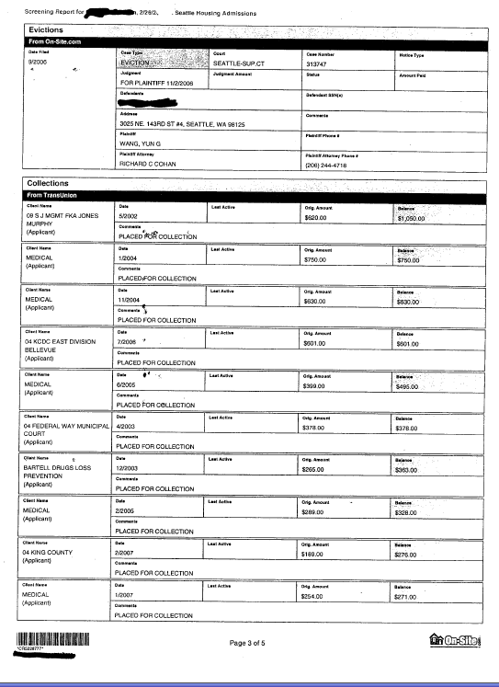
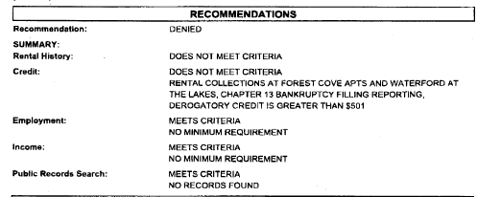
Eviction History
Collection Accounts & Civil Judgments
Recommendations

Slide 21
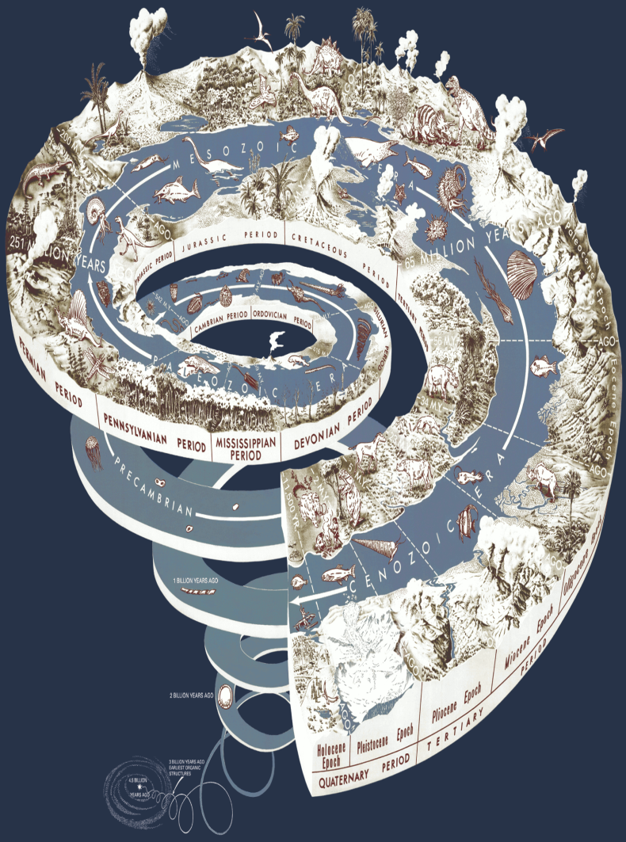
Outdated Information
Both federal & state FCRAs prohibit reporting of certain records after a period of time
    15 USC 1681c(a)
    RCW 19.182.040(1)
  Certain exceptions apply
  State & federal statutes are not the same

Slide 22
Time Limits: Federal (15 USC 1681c(a)
Bankruptcy
10 years from adjudication
Collection, tax lien, civil suit/ jdgmt, arrest
7 years from date of entry, or
Limitations period expires
Any other adverse information, except convictions
7 years

Slide 23
Time Limits: State (RCW 19.182.040)
Bankruptcy
10 years from adjudication
Collections, tax liens, civil suit/ jdgmt, adult criminal record
7 years or limitations period
Any other adverse information
7 years
Juvenile Record
Until subject is age 21

Slide 24
Exceptions (time limits not applicable)
Federal:
Credit or life insurance with $150k < principal
Employment application if $75K < salary
State:
Credit or life insurance with $50K < principal
Employment application if $20K < salary

Slide 25


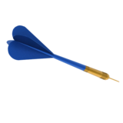
Consumer Reports: Accuracy
“Whenever a consumer reporting agency prepares a consumer report it shall follow reasonable procedures to assure maximum possible accuracy of the information concerning the individual about whom the report relates.”
-- 15 USC 1681e(b);
RCW 19.182.060(2)

Slide 26
Resale of Consumer Reports
Information one CRA obtains from another
Original CRA has duty to follow reasonable procedures to assure maximum possible accuracy
Reseller must accurately report the original information
15 USC 1681e(e)

Slide 27


Maximum Possible Accuracy
To be of “maximum possible accuracy,” information must be:
True
Complete
Presented in a way that is not misleading

Slide 28
Criminal Records – 1 Found!
State: WA | County: King | No 99-00000-0 | D: GUILTY
Charge: Burglary 2° (Felony) |  | Sentence: PROB 36 mo
Notes:
Hint: If this report was made in connection with a 2011 transaction, might it interest the user to know that the offense and disposition occurred in 2000?

Slide 29
Reasonable Procedures
CRA not liable for inaccurate report alone
Two-step analysis:
Consumer must show prima facie case: inaccurate report
CRA can avoid liability by proving it followed reasonable procedures
Notes:
Going to take an egregious case to obtain liability based on inaccurate report alone – no field for critical info.

Slide 30

FCRA Disputes
15 USC 1681i; RCW 19.182.090

Slide 31
Dispute Procedure: Summary
Consumer may dispute item with CRA
CRA must “reinvestigate” the disputed information item within 30 days
CRA must correct or delete the disputed information item unless verified
CRA must notify user(s) if information is changed or deleted as a result of a dispute

Slide 32
FCRA Disputes (II)
CRA must use reasonable procedures to reinvestigate, verify disputed information
Must consider information consumer submits
CRA may not charge a fee for reinvestigating
CRA must notify furnisher of disputed item
Federal FCRA permits consumer to lodge dispute directly with furnisher, 15 USC 1681s-2
Dispute Statements
If reinvestigation does not resolve dispute, consumer may file “brief statement setting forth the nature of the dispute” for inclusion in future reports

Slide 33
Automated Reinvestigation (e-Oscar)
15 USC 1681i(a)(5)(D):
  “Any consumer reporting agency that compiles and maintains files on consumers on a nationwide basis shall implement an automated system through which furnishers of information to that consumer reporting agency may report the results of a reinvestigation that finds incomplete or inaccurate information in a consumer’s file to other such consumer reporting agencies.”
  e-Oscar (www.e-Oscar.org)
    ACDVs initiated by a CRA on behalf of a consumer are routed to the appropriate Data Furnisher [and] is returned to the initiating CRA with updated information (if any) relating to the consumer's credit history. If an account is modified or deleted, carbon copies are sent to each CRA with whom the DF has a reporting relationship.
Plain English: nationwide CRAs must subscribe to a system that enables furnishers to automatically update consumer information on file with the CRAs

Slide 34





Remedies: Federal FCRA
Negligent Violations (15 USC 1681o)
  Actual damages
  Costs & Attorney Fees
Willful Non-Compliance (15 USC 1681n)
  Actual or statutory damages ($100 to $1,000)
  Punitive damages (as determined by court)
  Costs & Attorney Fees
Guimond v. Trans Union, 45 F.3d 1329 (9th Cir. 1995)
  Denial of credit not a prerequisite for actual damages
  Actual damages can be emotional distress/humiliation

Slide 35
Remedies: Washington CPA
Violation of state FCRA is per se violation of Wash. Consumer Protection Act, RCW 19.86
Relief available:
  Actual damages
  Costs of action & Attorney Fees
  $1,000 “penalty” for a willful violation

Slide 36
End Users (of consumer reports)
Pre-screening disclosures
Employment: RCW 19.182.020(2)
Housing: RCW 59.18.257(1)(a)
Content restrictions
Employment: RCW 19.182.020(2)(c) (credit info.)
Housing: None (but see S.L. 6315 of 2012)
Pre-adverse action notice
Employment only: RCW 19.182.020(2)(d)
Adverse action notice
General: RCW 19.182.110
Housing only: RCW 59.18.257(1)(c)
Notes:
Remedies not very strong; 1681m not privately actionable

Slide 37
Furnisher Duties
15 USC 1681s-2 (Federal FCRA Only)
  May not furnish information to a CRA if:
    Person “knows or has reasonable cause to believe that the information is inaccurate;” or
    Information is inaccurate and consumer has notified the furnisher of the inaccuracy
  Must correct and update information
    Person must regularly furnish information to CRAs
    Duty to promptly notify CRA of inaccurate information
  Must inform CRA if consumer disputes item
Nelson v. Chase Manhattan Mtg. Corp., 282 F.3d 1057 (9th Cir. 2002)
  Private cause of action against furnisher for violation
Notes:
the term “reasonable cause to believe that the information is inaccurate” means having specific knowledge, other than solely allegations by the consumer, that would cause a reasonable person to have substantial doubts about the accuracy of the information.

Slide 38
Furnisher Disputes
Consumers may dispute item directly with furnisher
  15 USC 1681i(a)(8) will entitle
  Dispute must:
    Identify specific information disputed
    Explain basis for dispute & evidence
    Delivered to furnisher at proper address
  Furnisher must:
    Investigate (same basic procedures as CRA)
    Written notice of determination to consumer
    Promptly report any corrections to CRAs
  FTC regulations: 16 CFR 660.4

