Slide 1

VACATING AND Sealing CRIMINAL records
A Clean(er) Slate in the Information Age?
Daron Morris
Deputy Director and Felony Supervisor
The Defender Associationd
daron.morris@defender.org

Slide 2

Criminal History – Generally Indestructable
It is never “expunged”
It’s very rarely destroyed
Proliferates
Same goes for juvenile history

Slide 3
Where is Criminal History Found?
Court records at the courthouse
  Includes dismissed cases and acquittals
JIS – online court records
Washington State Patrol website
Police agencies
Private companies large and small

Slide 4
Where does it go?
Conviction
courthouse
Private companies
Washington
State
Patrol
internet
FBI
JRA/Detention
Internet
Internet

Slide 5
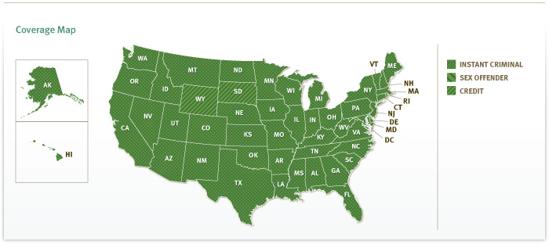
The Beast
Access more than 1 billion criminal and evictions records
With one of the world's largest privately maintained criminal databases, CreditRetriever can help improve safety and security at your properties. You get access to more than 1 billion criminal and eviction records updated weekly from across the country.

Slide 6
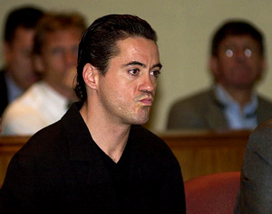

Vacating the Conviction – A Rehab Statute

Slide 7
BEWARE!
NOT AN ACQUITTAL OR A PARDON
REHABILITATIVE
DOES NOT RESTORE FIREARMS RIGHT!!
DOES NOTHING FOR IMMIGRATION ISSUES!!

Slide 8
Police Records – Criminal Records Privacy Act – RCW 10.97
Police agencies may freely disseminate “conviction record”
conviction record includes any adverse finding:
  deferred sentences
  Bail forfeitures
  stipulated orders of continuance (depends)
“non-conviction data” includes:
  arrests
  outright dismissals
  not guilty verdicts (but not NGRI).

Slide 9
Police Dissemination
RCW 10.97
  Conviction record can be disseminated without restriction
  “non-conviction data” can’t be disseminated to private companies or individuals unless within one year of incident and active court case ongoing
  “non-conviction data” is destroyed three years after arrest, or two years after dismissal, but only upon request and with no other arrests

Slide 10
Vacating Statutes
Felonies (post-SRA) - RCW 9.94a.640
Felonies (pre-SRA) – RCW 9.95.240
Misdemeanors – RCW 9.96.060
Juvenile – RCW 13.50.50

Slide 11
Effect of Vacating
Removes guilty finding and substitutes not guilty
Dismisses Information
Relieves person from “all penalties and disabilities”
Can say “never convicted”
Court must immediately transmit order to WA State Patrol and to local police agency, then to FBI
Agencies must not disclose conviction except to other criminal justice enforcement agencies.

Slide 12
Deferred Sentences
  Superior Court – relief from all penalties and disabilities upon completion – RCW 9.95.200 – .240
  LJ Courts – no similar provision – RCW 3.66.067
BUT, State v. Breazeale and In re Carrier
  - it shouldn’t matter

Slide 13
Restrictions
Crimes Against Persons or Violent Offenses.
Any new charges pending.
Any subsequent convictions. (possible exception for felonies)
LONG WAITING PERIODS
LFO’s and certificates of discharge
  Nunc pro tunc discharges
For misdemeanors – the offender has ever had a prior vacation.

Slide 14
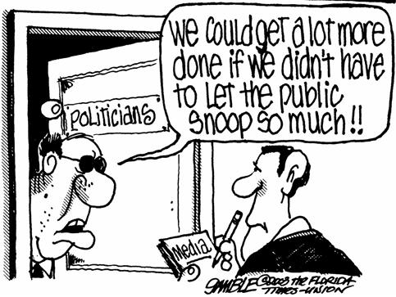
Sealing Records

Slide 15
The Broader Open Courts Movement in the Courts
Chambers discussions
Sidebars
Juror Questionnaires
Mitigation letters to prosecutors (PRA)
Mental Health Evaluations

Slide 16
Sealing Records
VERY DIFFICULT TO SEAL:
  “identified compelling privacy or safety concerns that outweigh public interest in access to court record.”
    Requires more than just vacated or dismissed case.
    Employment: imminent threat, not speculative McEnry, 124 Wash.App. 918,.
  Hearing in Open Court with notice to victim and CCO
  Court must not seal when redaction is adequate.
  Must be least restrictive in duration
  Seattle Times Co. v. Ishikawa, 97 Wash.2d 30 (1982); State v. Waldon, 148 Wash.App. 952 (2009)

Slide 17
JIS/SCOMIS
STILL AVAILABLE:
  case number, names of parties, “case sealed”, case type, copy of order sealing.
  for vacated criminal charges: case number, case type (with “DV” if applicable), defendant name, and “vacated”.
But see, Indigo Real Estate Services v. Rousey, 151 Wn.App. 941, 947-48 (2009) (allowing redaction of JIS/SCOMIS in housing case); but see Hundtofte v. Encarnacion, 280 P.3d 513

Slide 18
Sealing Juvenile Records
One Combined Motion
Same Effect as Adult Court
Eligible:
  Class A and most sex offenses eligible
  Only convictions where restitution, fees, assessments have been paid in full;
  Waiting periods (5 years Class A, 2 years everything else), consecutive residence in community without conviction or pending case

Slide 19
Destruction of Some Juvenile Records
Diversions: RCW 13.50.050 (17)
  Automatic Destruction for diversions entered after 6/12/08: Only one diversion, 18 years or older, 2 years have elapsed from the date of completion of the diversion agreement
  Pre-6/12/08 – must request destruction
  Multiple diversions - age 23 years or older if diversion agreements are completed and there are no pending offenses.

Slide 20

Cat Out of the Bag Problem

Slide 21
Solutions?
Certified copies of dismissal orders prior to sealing
Find out in advance what company is used
Individual request letters to private companies
Fair Credit Reporting Act – but remedies are generally inadequate. See: Broken Records, National Consumer Law Center: http://www.nclc.org/issues/broken-records.html
  Inadequate time to correct errors

Slide 22
An Effort at Reform
SB 5019 – and non-dissemination of “exonerating dispositions” and protection orders.
http://apps.leg.wa.gov/billinfo/summary.aspx?bill=5019&year=2011

Slide 23
Resources
ACLU Criminal Records Project
  http://www.aclu-wa.org/criminalrecords
WA Law Help
  http://www.washingtonlawhelp.org/WA/index.cfm
  Juvenile Records Sealing Project
  - http://teamchild.org/index.php/education/118/juvenile_record_sealing_project/

