Slide 1
Mass Incarceration Meets the Information Age
Vanessa Torres Hernandez Equal Justice Works Fellow
Email: vhernandez@aclu-wa.org

Slide 2
The Incarceration Boom
2.3 million people incarcerated.
5 million more under community supervision.
165,000 people confined or under community supervision in Washington.

Slide 3
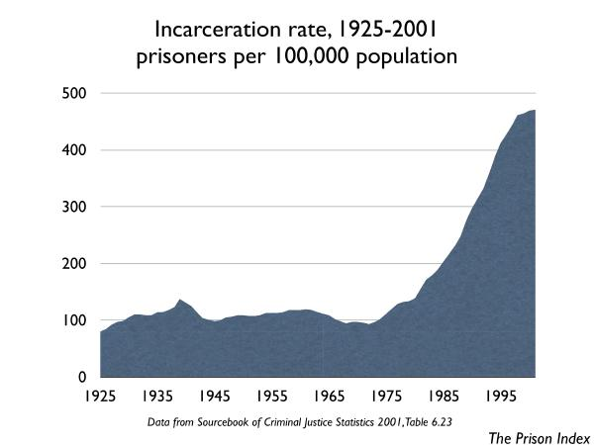

Slide 4
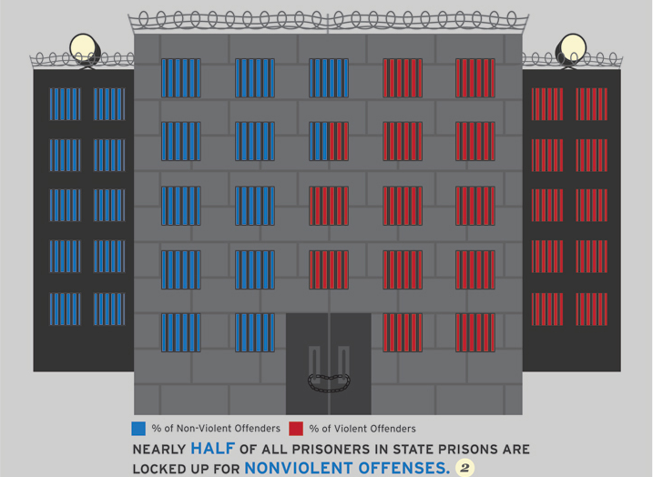

Slide 5
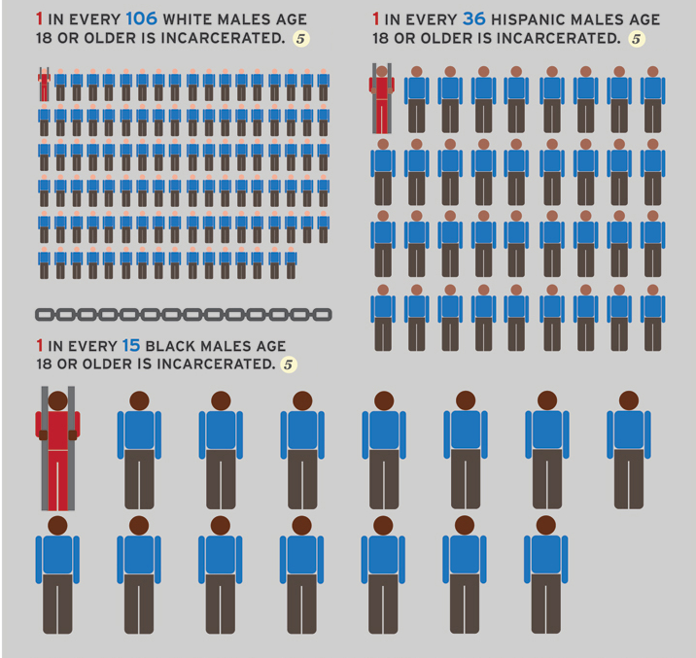
60% of African American males under the age of 40 who have not completed high school have spent a year in prison
Source: B. Western and Becky Pettit, Collateral Costs: Incarceration’s Effect on Economic Mobility (Pew Charitable Trusts 2010)

Slide 6
Racial Disparities in Washington
Incarceration: White people are incarcerated at a rate of 393 per 100,000 state population, African Americans are incarcerated at a rate of 2,522 per 100,000 state population, and Hispanics at 527 per 100,000 state population.
Conviction: African Americans 6 times more likely than whites to be charged and convicted of violent offenses than whites; 3 times more likely to be charged and convicted of property offenses, and 3.5 times more likely to be charged and convicted of drug offenses
(Preliminary Report on Race and Washington’s Criminal Justice System).
Drug Offenses: Washington “is the third most prolific incarcerator of Blacks for drug offenses in America” – although they make up only 3% of Washington’s population, 51% of people sent to State prisons for drug offenses are African American.
(Le Roi Brashears, “Same Crime, More Time,” Seattle P-I, (May 29, 2007))

Slide 7
Contact without Conviction
200,000 arrests in Washington last year.
[Washington Association of Sheriffs and Police Chiefs, Crime in Washington: 2011]
Many of those will not be convicted.
[King County Prosecuting Attorney]
All together, 1 in 4 Americans have a record
[National Employment Law Project, 65 million Need Not Apply, 2011]

Slide 8
Re-Entry
95% of prisoners will be released.
Source: Timothy Hughes and Doris James Wilson, Bureau of Justice Statistics, ReEntry Trends in the US (2012).
Over 700,000 people will be released from confinement this year.

Slide 9
Background Checks
Increasingly mandated for licensed industries
92% of employers conduct background checks on some or all applicants, up from 50% in 1996.
Source: Society of Human Resources Management, Background Checking: Conducting Criminal Background Checks (Jan. 2012); National Employment Law Project
Applicants with records half as likely to receive follow up interviews. African American applicants two-thirds less likely.
Source: Devah Pager, Bruce Western and Naomi Sugie, Sequencing Disadvantage: Barriers to Employment Facing Young Black and White Men with Criminal Records (2009)

Slide 10
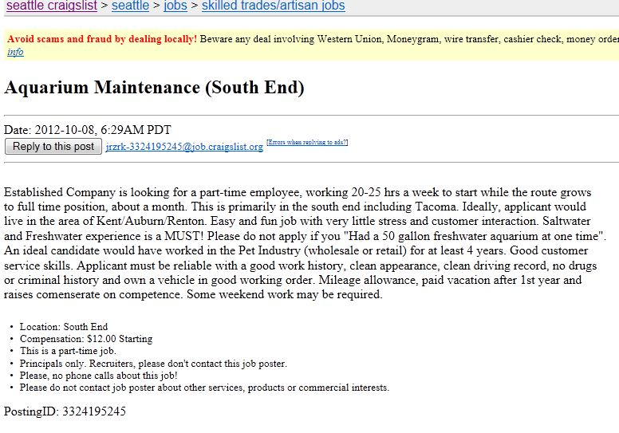
No Criminal Background

Slide 11
Job posting from Work Source

Slide 12
Criminal Records as Indicators
Most recidivism occurs within 3 years of arrest
Best criminological evidence suggests that after 7.7 years, a person with conviction is no more likely than any other to commit a crime
(Nakamura and Blumstein, Redemption in an Era of Widespread Background Checks (2009)
A person who is older when first arrested goes back to a typical hazard rate within 4.4 years

Slide 13
Social Impact
Economic Inequality
People with criminal convictions work less, make less money, and demonstrate less economic mobility, even decades after conviction.
Impact on children with incarcerated parents
Source: Western, B., and Pettit, B, “Collateral Costs: Incarceration’s Effect on Economic Mobility” (2010)
Increased Recidivism
Lack of housing and employment strongly correlated with re-offending.
Source: Visher, C. and Courtney, S., “One Year Out: Experiences of Prisoners Returning to Cleveland”, Urban Institute (2007)

Slide 14
Legal Framework
FCRA (federal)
WLAD
FCRA (state)
Vacating/Sealing
Title VII

Slide 15
ACLU Criminal Records Project
Direct client services
Vacating conviction records
Sealing court records
Potential representation in EEOC/Title VII claims
Client education
Community education
www.aclu-wa.org/criminalrecords

Slide 16
Other Resources
National Employment Law Project (www.nelp.org)
American Bar Association National Inventory of Collateral Consequences
(www.abacollateralconsequences.org)
National Consumer Law Center (www.nclc.org)

Slide 17
THANK YOU!
Questions?
Comments?
Brilliant Ideas?

